Slide 1
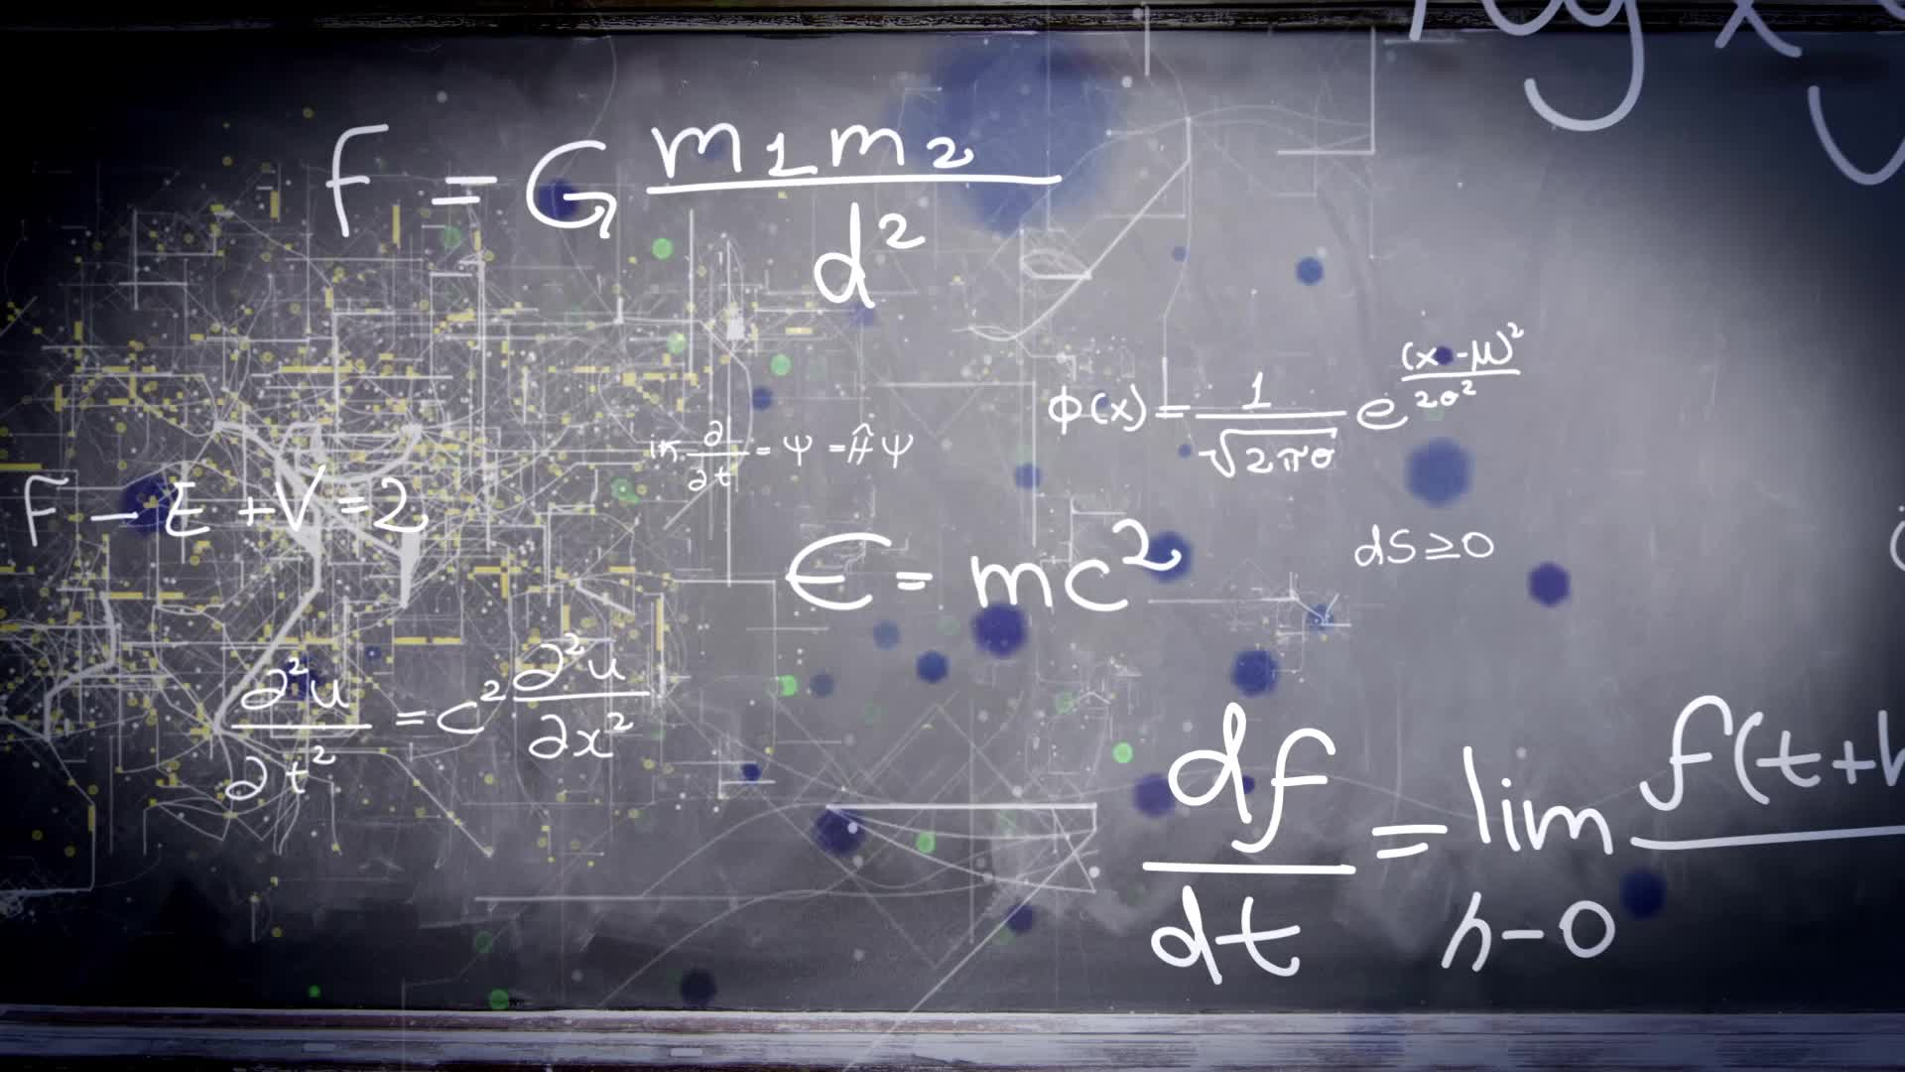

Society of Quantum Engineers Qiskit Fall Fest
Colorado School of Mines
Golden, CO

Slide 2
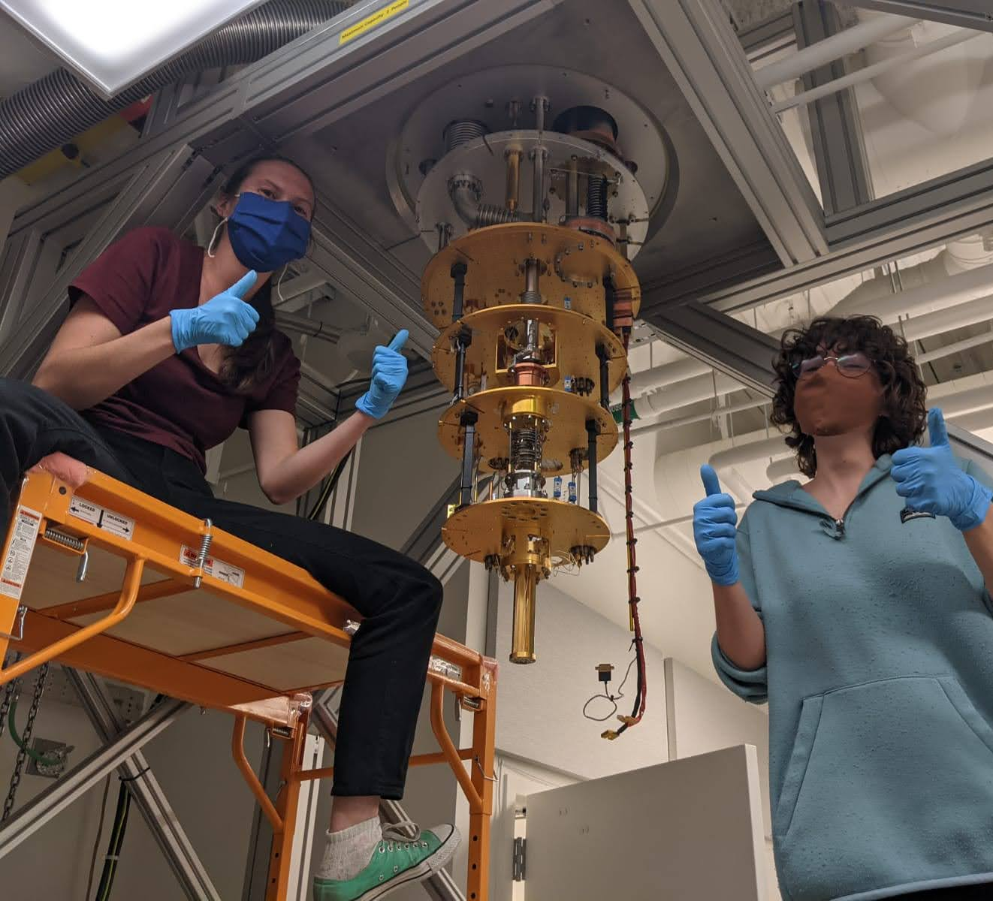
Introduction to Mines
R1 Research Institution
Quantum Engineering program is entering its third year
We have a quantum presence but it is still small and growing

Slide 3
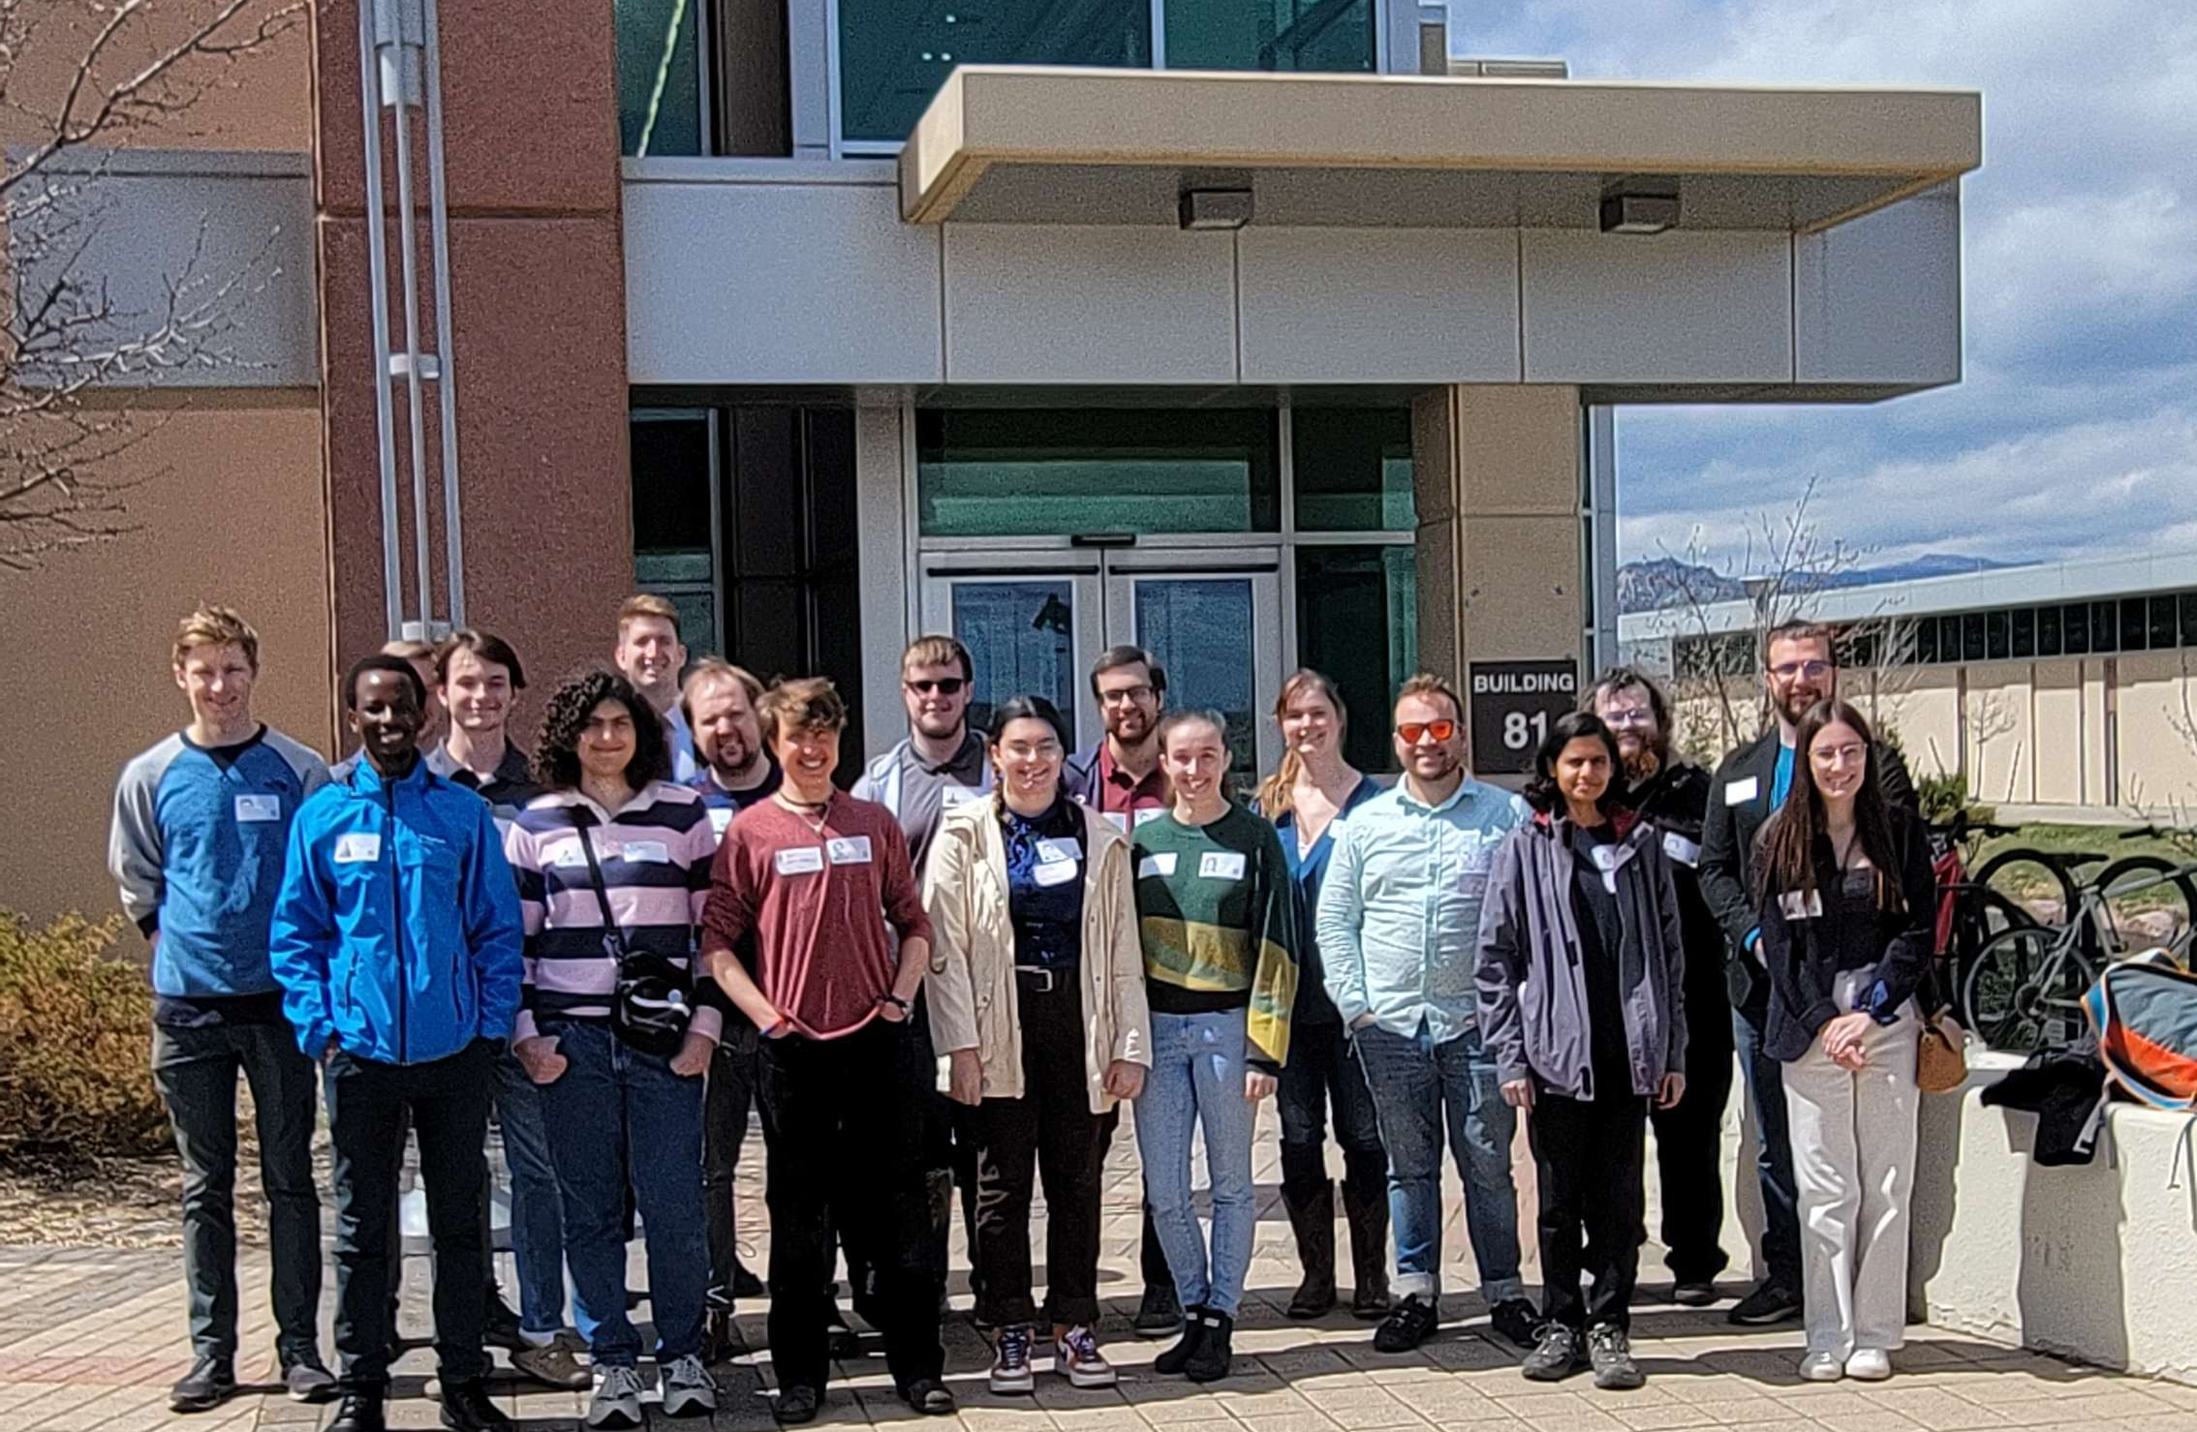
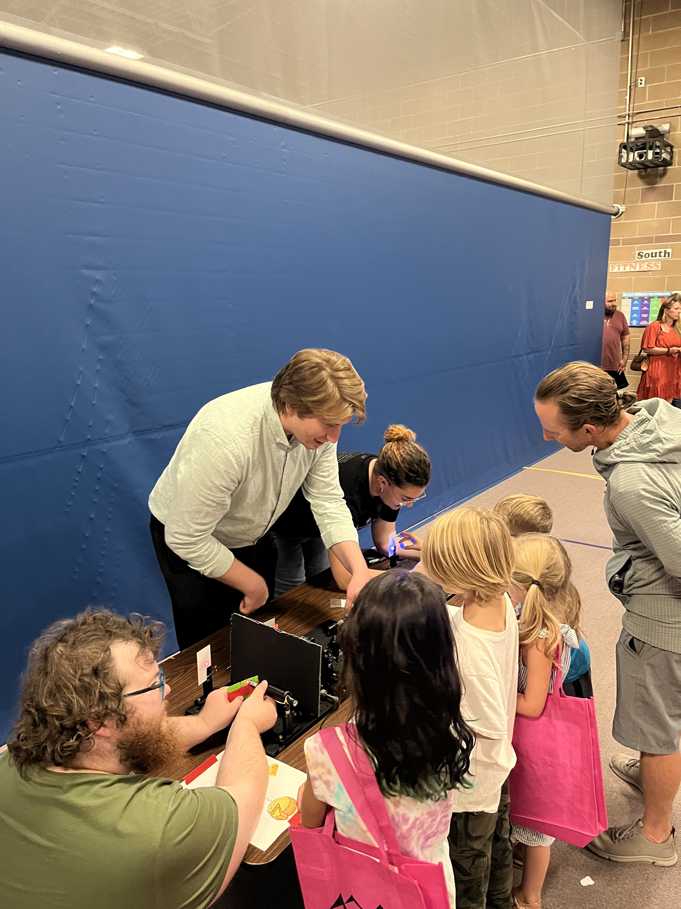
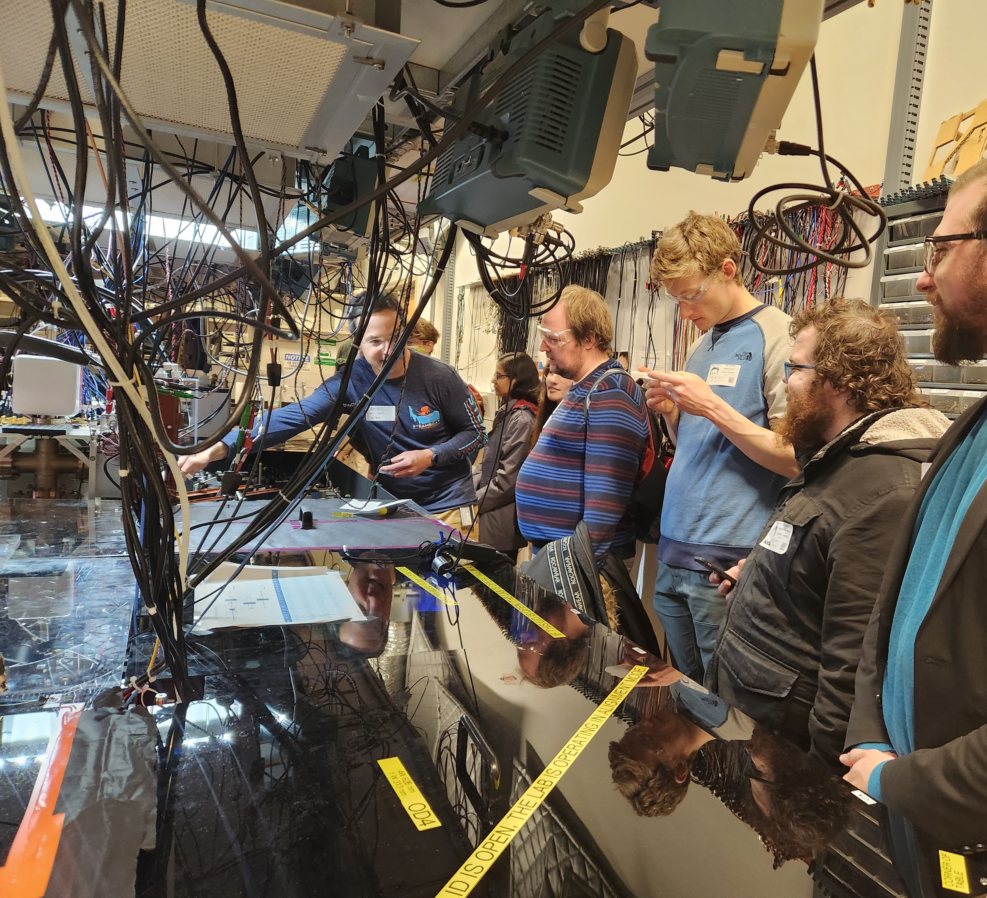
What is SQE?
We are a brand-new organization on campus supporting the professional, personal, and academic development of our Quantum-Inspired students
Tours of labs like NIST (bottom left)
Weekly Seminar Series from industry professionals
Bi-Weekly journal club for students to socialize and discuss new papers
Through outreach with local communities we bring quantum into the view of the public
Mitchell Elementary Science Night (bottom right)

Slide 4
Qiskit Fall Fest
Our Week of Quantum

Slide 5
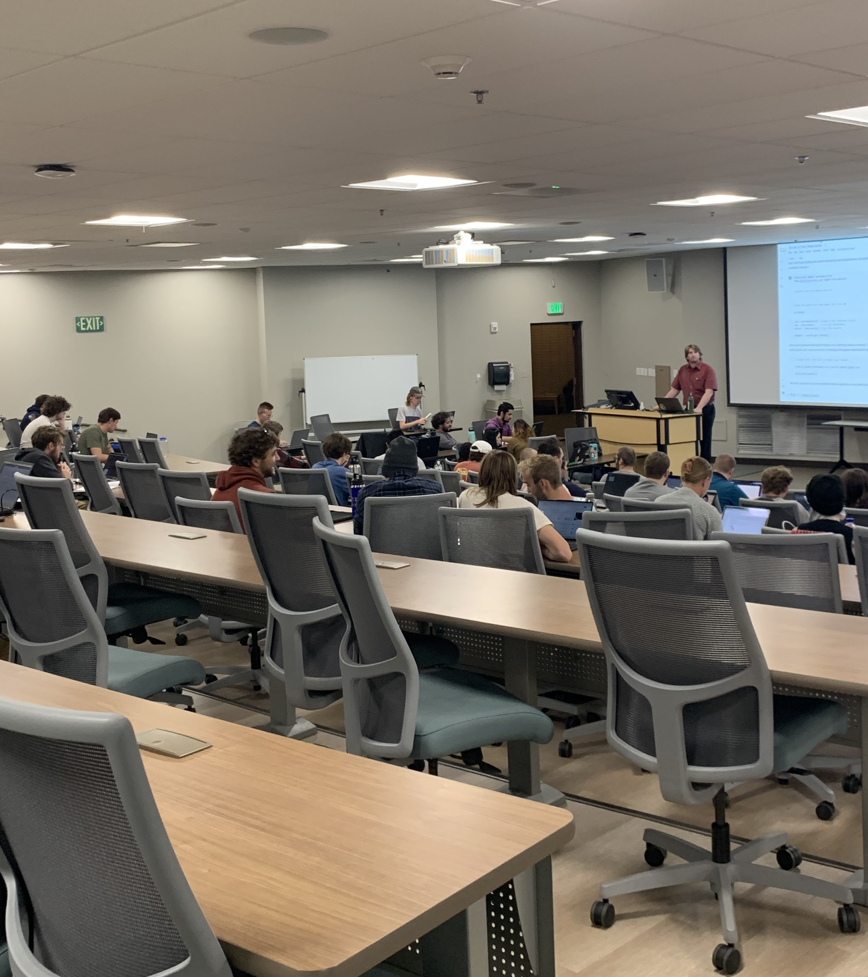
Monday – Quantum 101
Attendance of over 40 people, close to 90% of those who signed up on our website
Short lecture on quantum basics, then walkthrough of Lab A as a group
Groups for the hackathon were also formed, and most did not know each other before this event
Many stayed afterwards to ask us about coursework and pathways at Mines to pursue Quantum

Slide 6
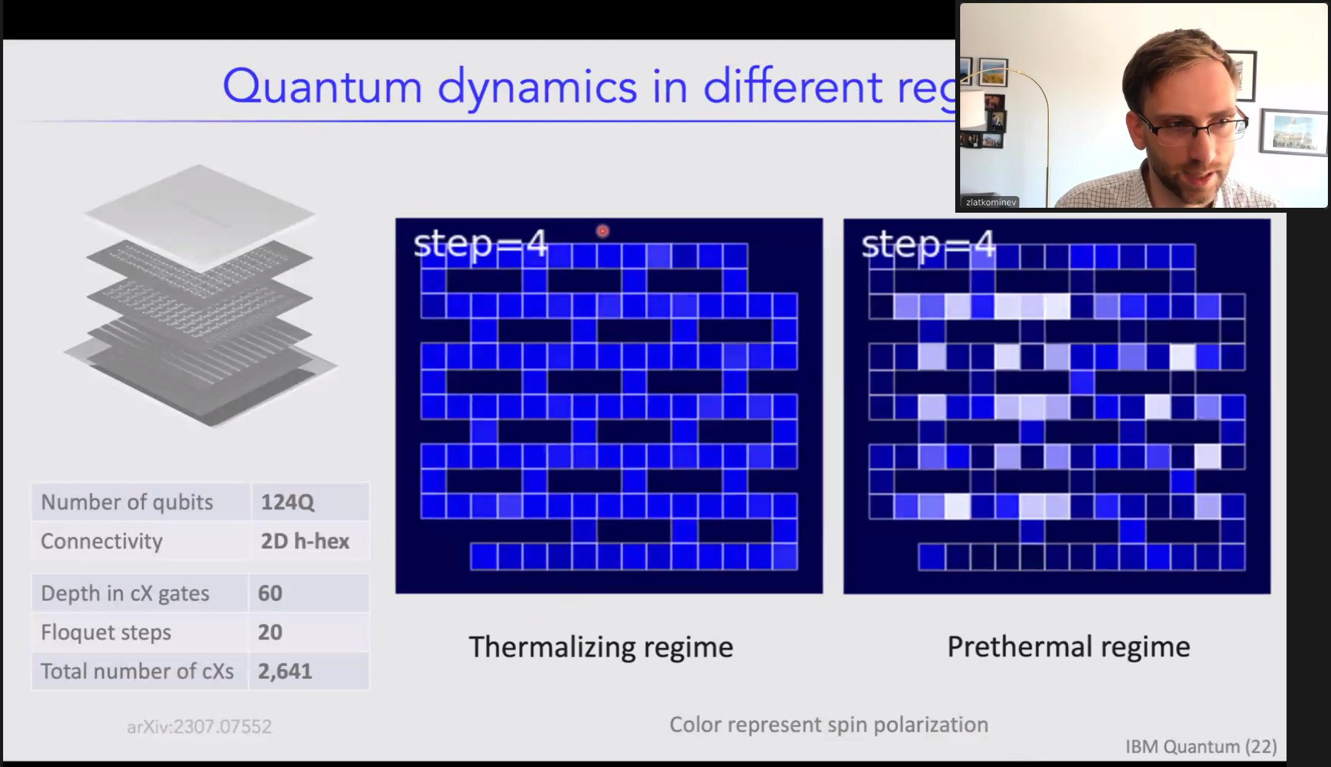
Tuesday – Quantum Engineering Seminar
Attendance of ~40 people
Hybrid in person and virtual with speaker from IBM
Speaker Zlatkov Minev gave an advanced talk on quantum dynamics

Slide 7
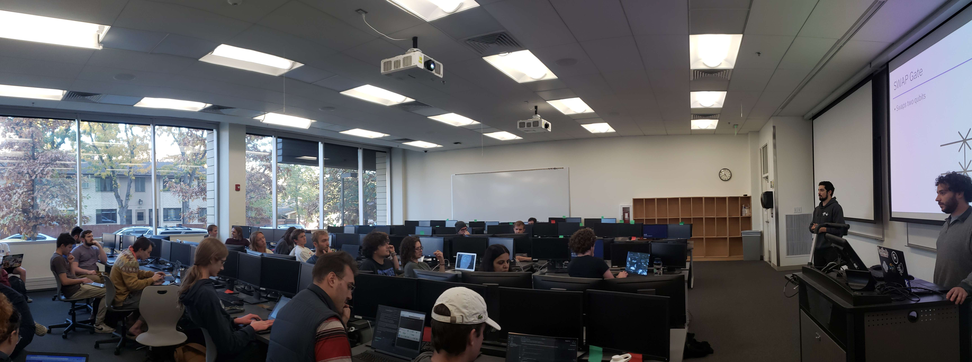
Wednesday – Advanced Quantum Workshop
Attendance of over 30 people, close to 90% of sign ups we received
Lecture from our exec team using Qiskit resources and Lab B
Many stayed afterwards to talk to us about our organization and Qiskit

Slide 8
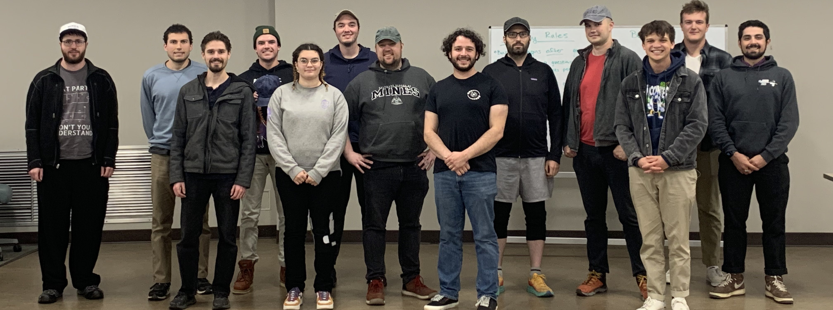
Friday – Hackathon Closing Celebration
Attendance of 6 teams
All teams who signed up submitted complete notebooks with perfect scores!
Played “Quantum Jeopardy” to determine team rankings

Slide 9
What’s Next?
When merch arrives from IBM we will re-gather the teams once again to receive prizes
This will help keep people engaged with SQE and Quantum
We hope to put together another Hackathon for higher level graduate and PhD students, who expressed desire for this
We hope future years of SQE will continue to host Qiskit Fall Fest
This was our most successful event as an organization so far!

